Slide 1
DENTISTRY
OVERVIEW
Dentists diagnose, prevent and treat problems with teeth or mouth tissue. They remove decay, fill cavities, examine X-rays, place protective plastic sealants on our teeth, straighten teeth, and also repair fractured teeth.
They also perform corrective surgery on gums & supporting bones to treat gum diseases. Dentists extract teeth and make models and measurements for dentures to replace missing teeth.

Slide 2
DENTISTRY
OVERVIEW (CONTD..)
Dentists provide instruction on diet, brushing, flossing, the use of fluorides, and the other aspects of dental care. They also administer anesthetics and write prescriptions for antibiotics & other medications.

Slide 3
Your smile can be your best Asset…..
Arrange for a consultation to discuss
Your beautiful smile!

Slide 4
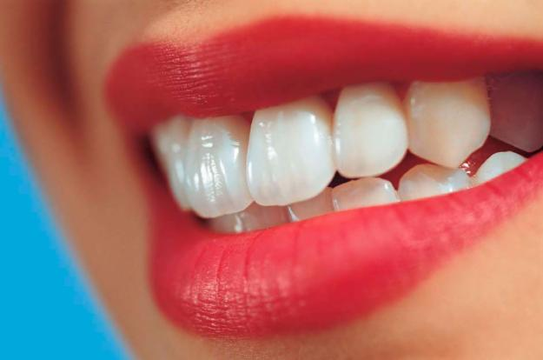
SMILE PLEASE ONE STOP SMILE SHOP
A MULTI SPECIALTY DENTAL UNIT
at New Alipur

Slide 5
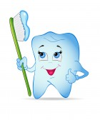
LOCATION
Gupta Sweets
SMILE PLEASE
New Alipur Petrol Pump
Tatatala
New Alipur Triangular Park
United Bank of India
SP-146 B. M. SARANI, GROUND FLOOR, NEW ALIPUR, KOLKATA-700 053
REMEDY HOURS:
Monday to Saturday 8 am to 10 pm Sunday 9 am to 6 pm

Slide 6
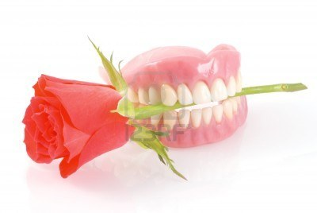
Our Specialties:
Tooth Extraction
Tooth Bleaching
Scaling & Filling
Single Sitting RCT
Crowning & Bridging
Broken Tooth Restoration
Wisdom Tooth Extraction
Tooth Lamination
Orthodontic Treatment
Pediatric Treatment
Oral Pathology
Diastema Closure

Slide 7
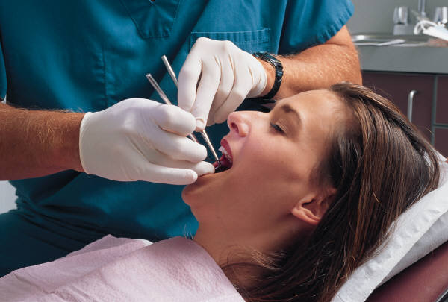
Our mission and vision…….
MISSION:
Our eminent team of doctors are committed to provide this care in a relaxing, comfortable atmosphere based on trust and respect. To provide wide range of high quality dental services at an affordable price to the patients.
VISION:
To deliver the highest quality dental care that will enhance our patients' health, appearance, and self-esteem.

Slide 8
Treatment Procedures done by our Specialist Doctors
BEFORE
AFTER

Slide 9
Treatment Procedures Contd…..
BEFORE
AFTER

Slide 10
Treatment Procedures Contd…..
BEFORE
AFTER

Slide 11
Treatment Procedures Contd…..
BEFORE
AFTER

Slide 12
Tips for keeping ‘Teeth’ and ‘Gums’ Healthy
Do’s:
Have a Balanced Diet.
Eat Fibrous fruits and vegetables.
Immediately brush your teeth after eating sweets/meals.
Brush your teeth at night before going to bed.
Take plenty amount of water.
Regular dental check up every six months.
Don’ts:
Eat sticky foods.
Eat frequently between meals.
Skip brushing before going to bed.
Drink carbonated/cold drink frequently.
Go for self medication.
Ignore your dentist’s advice.

Slide 13
We are Associated with……

Slide 14
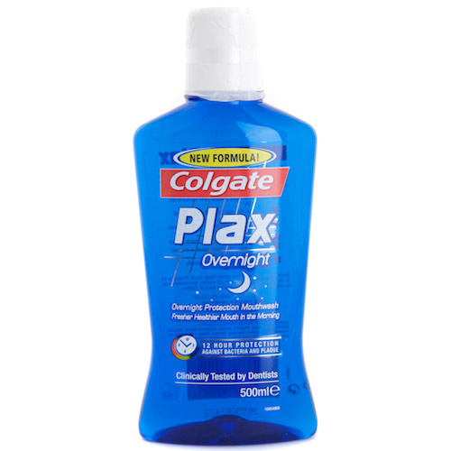
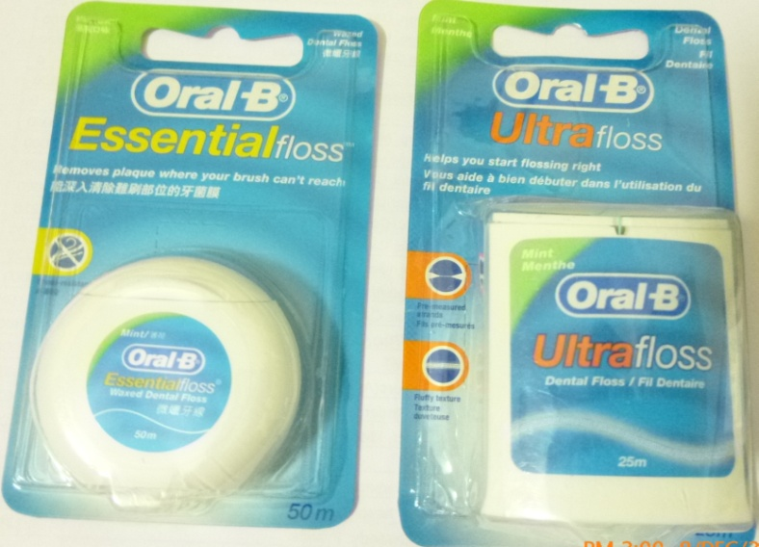
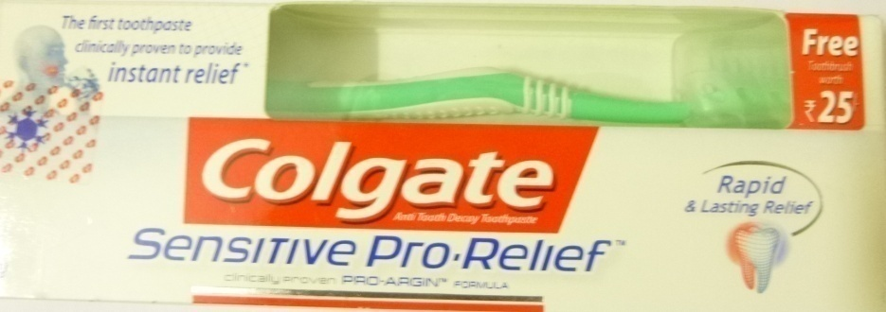
Products recommended by Doctors

Slide 15
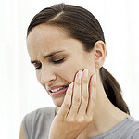
Dental Treatment EXPENSIVE ??? Think Again……….
Platinum Dental Treatment Plan Rs. 4999/-* includes
Diamond Dental Treatment Plan Rs. 3499/-* includes
Free Consultation for One Year
Free Root Canal Treatment up to 1 Unit
Free Dental Crown
Free Extraction for One Year
Free Tooth Coloured Filling
Free Ultrasonic Scaling & Polishing
Free Partial Dentures up to 4 Units
Free Dental X-Rays
Free Oral Cancer Screening
Free Tobacco Cessation Services
* Terms & Conditions Apply
Free Consultation for One Year
Free Root Canal Treatment up to 1 Unit
Free Extraction for One Year
Free Silver Amalgam Filling
Free Ultrasonic Scaling & Polishing
Free Partial Dentures up to 4 Units
Free Dental X-Rays
Free Oral Cancer Screening
Free Tobacco Cessation Services
* Terms & Conditions Apply
Silver Dental Treatment Plan Rs. 499/-* includes
Gold Dental Treatment Plan Rs. 1999/-* includes
Free Consultation
Free Ultrasonic Scaling & Polishing
Free Dental X-Rays
* Terms & Conditions Apply
Free Consultation for One Year
Free Extraction (Non- Surgical) for One Year
Free Silver Amalgam Filling
Free Temporary Filling
Free Ultrasonic Scaling (Twice in a Year)
Free Dental X-Rays
Free Oral Cancer Screening
* Terms & Conditions Apply
Quality Care, Comfort
And Affordable

Slide 16
OFFERS…….hard to say NO!!!
Kids Dental Treatment Plan Rs. 1499/-* includes
Beauty Package Plan Rs. 6000/-* includes
Free Consultation for One Year
Free Extraction of Milk Tooth up to 1 Unit
Free Pulpectomy up to 1 Unit
Free S. S. Crown
Free Fluoride Application
Free Tooth Coloured Filling up to 2 Unit
Free Ultrasonic Scaling
Free Dental X-Rays
* Terms & Conditions Apply
* Kids Age should be 5 yrs to 12 yrs
Free Consultation
Free Tooth Coloured Filling
Free Tooth Jewellery
Free Broken Tooth Restoration
Free Ultrasonic Scaling & Polishing
Free Tooth Whitening
* Terms & Conditions Apply
Senior Citizens ‘ASHIRWAD’ Plan includes
Free Consultation
10% on Dental Surgery
15% on Regular Dentistry
10% & 20% on Removable & Fixed Prosthesis respectively
20% on Endodontic Treatment
Free Oral Cancer Screening
* Terms & Conditions Apply
SMILE PLEASE presents First time in New Alipur
To avail more Lucrative Discounts on Smile Designing please contact………….9051030343

Slide 17
Should We arrange an Appointment for you?

